Slide 1
Mixed Media Modeling & Customer Acquisition
Capstone Project Report
By Jethro Perez

Slide 2
Preface (for those who are grading only)
This slide is intended to state the outline and logic of this deck to those who will be viewing and critiquing the format.
My assumption here is that I would be presenting this to an audience of key stakeholders and executives of the team whose problem I have been asked solve.
With that said the material and overview is meant for a non technical audience who are more interested in the findings and recommendations as opposed to a long presentation with tons of statistical jargon or what the full process was. That material is outlined in detail in my written report.
I am more than open to changing this if there is negative feedback but in my experience presenting at 3 different organizations to various levels of employees including CEOs and CFOs people are more interested in results, insights and recommendations in Power Point presentations as opposed to long form stories about the entire process.
The audience has a background in marketing so some terminology that is used is believed to be understood unless otherwise explained (ex. The team understands what attribution and non-paid acquisition is)

Slide 3
Table of Contents
Introduction (Slide 4)
Data Acquisition/Wrangling (Slide 5)
Exploratory Data Analysis (Slides 6-9)
Modeling (Slides 10-11)
Results (Slides 12-13)
Recommendations (Slide 14 In order to do so we will need to revisit the data collection stage. )

Slide 4
Introduction – What are we trying to understand
The Marketing Team wants to know the most optimal mix of media spend that minimizes cost per acquisition.
The model that is generated would be used to alter the current acquisition plan should it be different than the current plan.
It would also be used to predict future customer acquisition given a fixed budget.
Solving this problem requires us to understand how marketing spend by partner impacts customer acquisition.

Slide 5
Data Acquisition/Wrangling
Daily spend data was gathered from third parties and married with first party customer counts from January 2016 through July 2017.
The reason for using first party customer counts is due to the nature of over attribution among the 12 advertisers that we have sampled.
In an ideal setting an attribution model would assist in answering the questions posed but given that it is not an option at this point we will use the data available to solve the problem at hand.
We collected data for all four of the products we spend advertising dollars on but we will focus our attention to Product 1 which is our largest in both spend and customer counts. Should you be pleased with the results we can extend our model to the other three.

Slide 6
Exploration Process
Given the nature of the problem, homogeneous predictor variables and lack of categorical data the exploration process was limited to generating summary statistics and understanding the nature of each predictor on the response.
Over the 579 day period the organization acquired 405 new customers per day at an average cost per acquisition of $361*
Advertisers E, H, J & M were removed from the analysis due to spending $0 during this period for this particular product.
Advertiser A and I are accountable for 77% of the average spend per day with the former taking 49% of the budget. We will see how this impacts our recommendations at the end of the deck.
Notes:
This figure was generated by averaging spend over the data set for only product 1 and dividing by 405. It is an estimate as most CPAs are on the product level since other costs must be taken into consideration.

Slide 7
Exploration Process Continued
Given the nature of the advertising world and how many touch points it takes someone to eventually purchase we need to understand how a given partner impacts customer acquisition as well how each partner moves with each other.
The plot on the next page shows what is known as a correlation matrix. I have taken the log of the data which makes trend spotting an easier task on the eye.
The bottom panel shows a scatterplot of each advertiser on customer acquisition. Advertisers A, G, I, K & L all show positive linear association with customers indicating their importance our future model.
There also seems to be some association between advertisers indicating synergy between certain partners.
Synergy from a machine learning perspective indicates that variables not only impact the response (e.g. customer acquisition) but are also impacted by each other. This makes sense from a marketing perspective since a customer may need to see an advertisement multiple times in different areas to convince her to try the product.

Slide 8
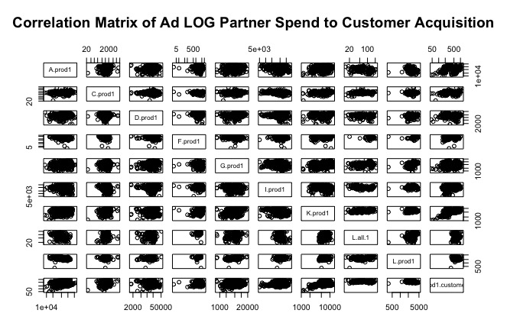

Slide 9
Exploration Process Continued
Given the general structure of the data I was led to conclude that a linear model would be an ideal algorithm to use for this specific problem.
While there are a bevy of other routes that can be taken the one chosen offers you interpretability and minimizes the complexity and assumptions that others require.

Slide 10
Modeling Process
Given the nature of the data we start with a model called multi variable linear regression using ordinary least squares (OSL).
This is a commonly used model to predict an outcome based in a set of inputs. In our case the outcome is customer counts and the set of inputs is the advertising partners.
Before we start the process we split the dataset into a training and test set. The former is used to build the model while the latter is used to test the accuracy of the model on real data. This is done to ensure that we select the strongest model that can predict on data that it has never seen before.
We begin by building a baseline model which simply uses all advertisers to predict customer counts.
Once we build a baseline model we analyze its effectiveness on the test set. If the model performs poorly we begin to alter the variables or use a different modeling technique until we are confident that we have the best model given the data set.

Slide 11
Modeling Process Continued
The baseline model performed poorly based on some key statistical measurements used to gauge a models accuracy. This is mainly due to the fact that some ad partners work in unison and the basis of OSL for multiple predictors assumes partial effects holding all else constant.
Since the baseline model uses ad spend individually holding all other variables constant we need to add interaction terms to solve for this. Interaction terms solve allow us to measure the effects of synergy between two advertisers. It gives us an understanding of how two specific ad partners working together impact customer conversion.
Our new model starts off with all variables again and interactions with each variable. From there I use variable selection to find the optimal model based on each distinct combination as well as some summary statistics used in the baseline model.
I trimmed the new baseline model which had 45 variables (9 predictors and 36 combinations of 2 partners) down to 8 significant variables. This was done in a stepwise fashion that found the best model from all predictors to one. Using three different statistical measures all indicated that the best model only needs 8 predictors to estimate customer acquisition.
Lastly I used a more modern technique than OSL called Ridge which minimized the effects of synergy by producing an adjustment for each predictor.
The results of all three techniques are found on the next page.

Slide 12
Results
Technique | Model Output | Adjusted R^2 | Takeaways
OSL Baseline Model | Customers = A.prod1 + D.prod1 + F.prod1 + I.prod1 + K.prod1 + L.all.1 + L.prod1 | 53.23% | This model performed the poorest of all three techniques because there are no interactions
Best Subset Selection | Customers = A.prod1 + L.prod1 + A.prod1 * D.prod1 + A.prod1 * I.prod1 + A.prod1 * L.all.1 + I.prod1 * K.prod1 + I.prod1 * L.prod1 + L.all.1 * L.prod1 | 68.36% | Performed the best out of the three due to fact that we ran simulations based on all possible combinations
Ridge Regression | Customers = A.prod1 + D.prod1 + F.prod1 + I.prod1 + K.prod1 + L.all.1 + L.prod1 | R^2 = 53.77% | Slightly better fit but this doesn’t have any interaction terms and the technique doesn’t use variable selection.

Slide 13
Results Explained
Adjusted R^2 is a statistical measure used to determine how much of the variation of the input variables explain the output. R^2 will rise as you add more variables so adjusted R^2 takes into account adding another predictor.
What this says is that the baseline model explains 53% of the variation in customer spend. That is not a good model.
We were able to make a 29% improvement from the baseline model but there can be more room to improve here depending on how you will use this model.
There is a natural inclination to maximize the adjusted R^2 but doing so may result in what is called overfitting a model which occurs when use too many predictors and thus have to place more assumptions on the model.
I tested the models on the training data and each produced a similar R^2 value when using it on the testing set.

Slide 14
Reccomendations
After examining the data, understanding its behavior and using a bevy of machine learning techniques I believe we are on the right track to create a model that will build on top of what we currently have. In order to do so we will need to revisit the data collection stage.
This leads me into my first recommendation which is to adopt or build a multi-touch attribution model. This will give us an understanding of how many touch points a customer has on average as well as any latency affects of advertiser spend.
My second recommendation is to get a deeper understanding into customers who convert through non-paid acquisition channels. In this model we assumed that all customer counts were a result of advertising spend when we know that in reality a subset is not. If we have a general sense of what that number can be we can take a set of those customers out of the total counts which can improve model performance. Adopting an attribution model will also give us a better understanding of this number.
My last recommendation involves spending considerably less on the advertisers who weren’t in the model. Leaving them out didn’t impact the performance which leads me to believe that some advertisers may just be taking credit for conversions because users just happen to be on that platform. Doing so would reduce your CPAs and allow you to either save that money or divert it to the channels that produce the highest customer counts

Slide 15
The End
If you have any follow up questions or are interested in a more in depth understanding of the modeling techniques I have a PDF located on Github.
https://github.com/jethrozperez/capstone1

